Slide 1
CAPSTONEPROJECT AUTOMATION ON OPENMRS HOSPITAL MANAGEMENT SYSTEM
Name: Nomula Sushma
Superset-id:2874496
JAVA SELENIUM BATCH-4

Slide 2
CONTENTS
Project overview
Tools & Technologies used
Project structure
Feature files
Runner class
Step definitions
POM Class
Utility Classes
Project Configuration &Build Management
Extent Reports
Cucumber Reports
Screenshots
Console Output
Git Repository

Slide 3
project overview
This project automates the Hospital Management application using a scalable
selenium Java framework with maven build tool ,cucumber BDD model and
TestNG integration , data-driven testing , providing reusable utilities ,test-data
files, cross browser testing and reporting.

Slide 4
TOOLS & TECHNOLOGIES USED
Java – Programming language for writing test scripts.​
Selenium WebDriver – For browser automation and interaction.​
Maven – Build automation and dependency management tool.​
TestNG – Testing framework for organizing and executing the test cases.​
Cucumber BDD – Behavior Driven Development tool for writing tests in Gherkin syntax.​

Slide 5
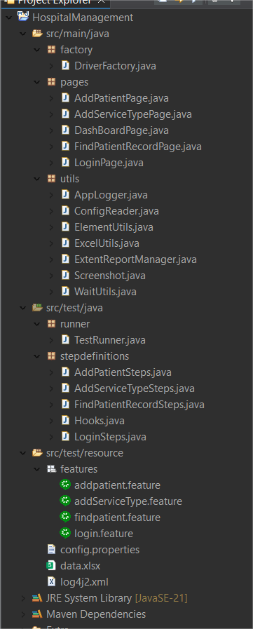
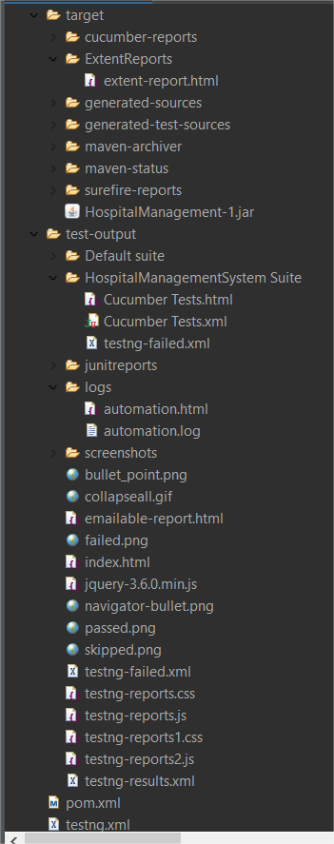
project structure

Slide 6
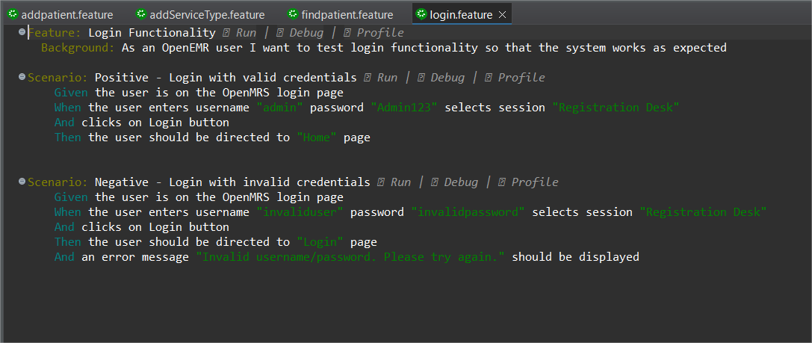
FEATURE FILES
login.feature
Positive: Valid credentials → Dashboard is displayed
Negative: Invalid credentials → Login error message

Slide 7
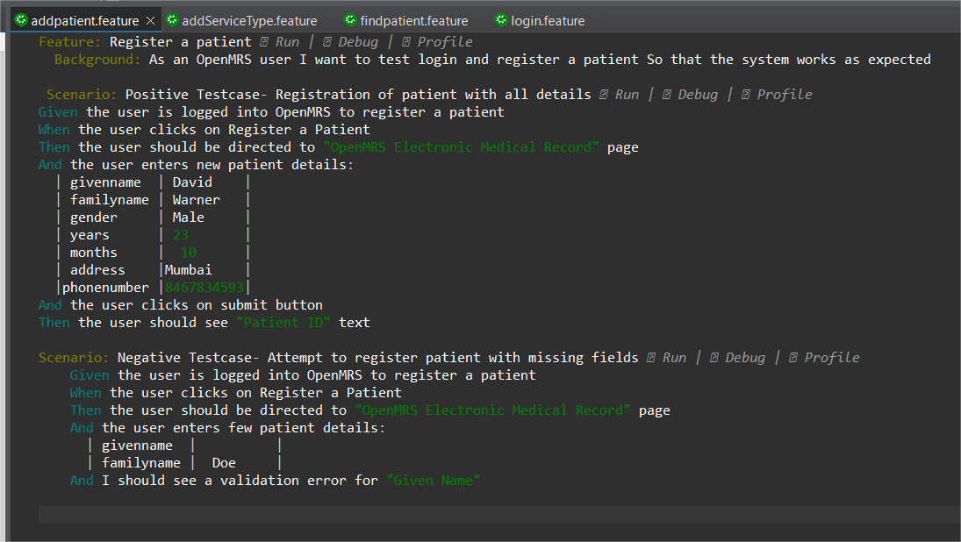
addPatient.feature
Positive Testcase: All valid details → Verify success creation of patient ID
Negative Testcase: Missing required fields → validation error

Slide 8
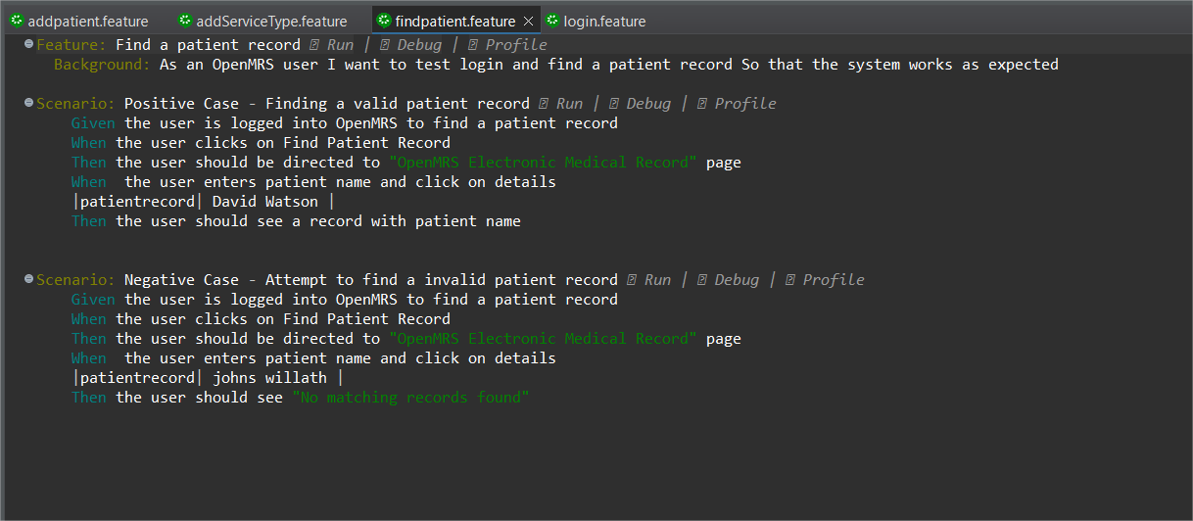
findpatient.feature
Positive Case: Search by valid name → verify record found
Negative Case: Search by invalid name → verify no matching record found

Slide 9
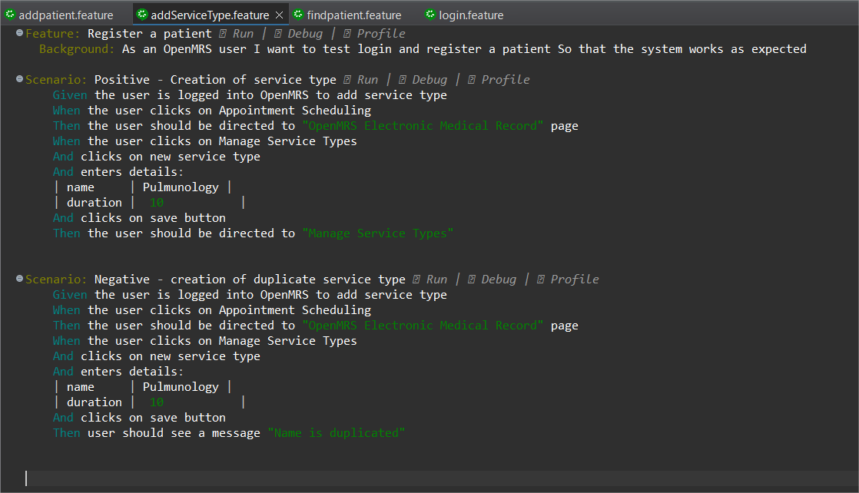
addServiceType.feature
Positive: Add new service type → verify dashboard
Negative: Add existing service type → verify message

Slide 10
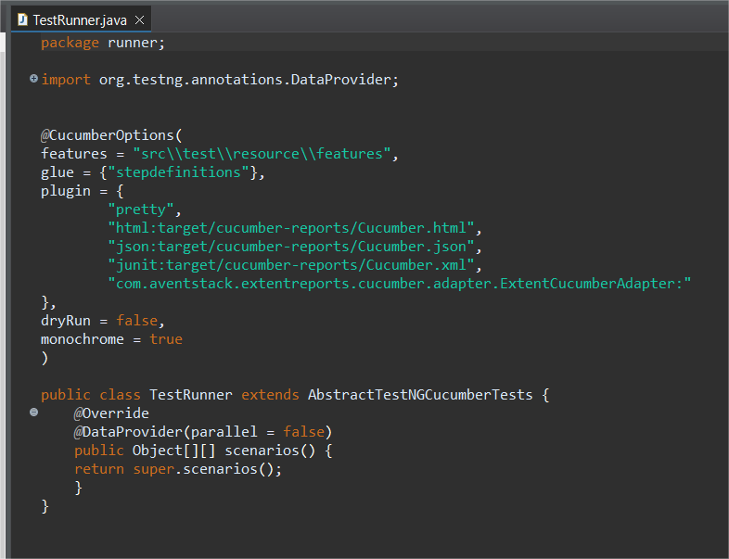
Runner class
The runner class executes feature files by integrating cucumber with
TestNG (stepdefinitions) and generates HTML and JSON reports.
TestRunner.java -

Slide 11
Step definitions
Hooks.java
The Hooks class manages setup and teardown for all scenarios, initializes webdriver before every scenario and quits the browser after every test.
It also integrates extent reports, captures screenshot for every step and logging status of steps to generate reports.
LoginSteps.java
Contains stepdefinitions for login and interacts with LoginPage.
Validates scenarios with TestNG assertions.
Handles data from cucumber data tables, properties file and excel.

Slide 12
FindPatientRecordSteps.java
Contains steps for finding the patient record for valid and invalid patient name.
Handles dynamic data from cucumber data table.
Validates steps with TestNG assertions.
AddPatientSteps.java
Contains stepdefinitions for adding patient record by interacting with AddPatientPage.
It validates both positive and negative scenarios with TestNG assertions.
Handles dynamic data from cucumber data tables.
AddServiceTypeSteps.java
Contains steps for adding service type.
Uses extent reports for step logging.
Validates steps with TestNG assertions for both positive and negative scenarios

Slide 13
page object model(pom) class
LoginPage.java
Represents the login page of OpenMRS application.
Provides reusable login method for entering credentials and clicking login for every stepdefinition classes.
Helps check if the login was successful or has and invalid credentials.
FindPatientRecordPage.java
Represents patient record search page under Find Patient Record menu.
Provides method to search patient record by name.
Checks whether record is found or not.
DashBoardPage.java
Represents the dashboard page that appears after successful login by verifying title of the page.

Slide 14
AddPatientPage.java
Represents adding patient under Register Patient Menu.
Provides methods to enter details of a patient save record in the system.
Verifies if patient record is creating or not by validating text.
AddServiceTypePage.java
Represents adding service type under Appointment Scheduling Module
Provides methods to enter role service, duration of appointment and save the service type.
Includes functionality to check whether service is created or already present.

Slide 15
utility classes
ElementUtils.java
Provides reusable methods to handle common WebElement actions and helps reduce code duplication and makes test scripts cleaner.
Simplifies interaction with elements like click, sendKeys, getText and dropdown selection.
Adds explicit waits for reliable execution.
WaitUtils.java
Provides reusable methods to apply explicit/implicit waits and ensures elements are loaded before interaction.
ExcelUtils.java
Provides methods by supporting data-driven testing by reading/writing test data from excel file to enable reusability.
Useful for large datasets in testing.

Slide 16
AppLogger.java
Helps in tracking execution flow of tests(start,steps,end) and analyzing test failures with logs.
Creates readable reports for stakeholders.
ConfigReader.java
Stores environment details like URL, browser, credentials, timeouts.
It is a helper class to read configuration values from a .properties file.
ExtentReportManager.java
Generates interactive HTML reports with test execution details and captures pass/fail/skip status for each test case.
Supports screenshots for success and failure steps.
Screenshot.java
Captures screenshots of the current browser window during test execution.
Can be attached to extent reports for manual review by QA/Stakeholders.

Slide 17
base class
DriverFactory.java
It handles WebDriver initialization and provides support for cross browser testing.
Avoids code duplication of driver setup across tests.
It manages maximizing the window browser and launches browser before every test.

Slide 18
project configuration &build management
pom.xml
Project Object Model manages project configuration, dependencies, plugins, and build settings.
It configures maven plugins for integrating reporting tools, enables parallel execution and report generation.
testng.xml
It defines the TestNG suite by specifying which classes or packages to run.
It ensures the cucumber TestRunner is executed for all the feature files.

Slide 19
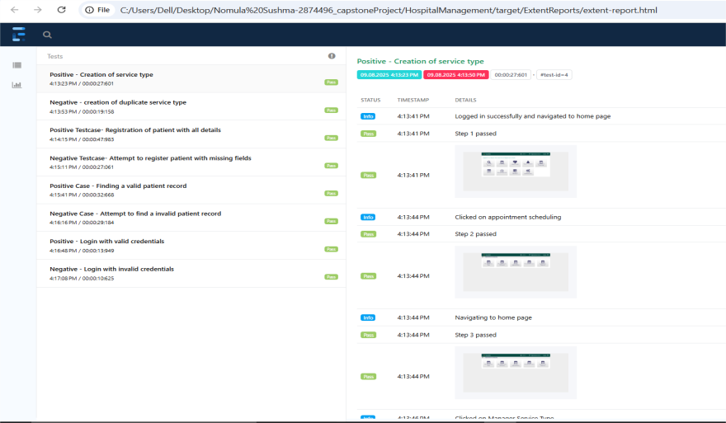
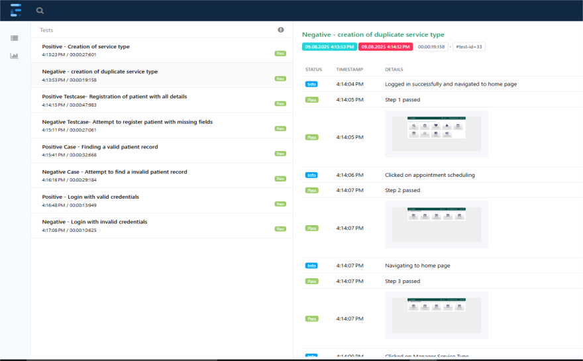
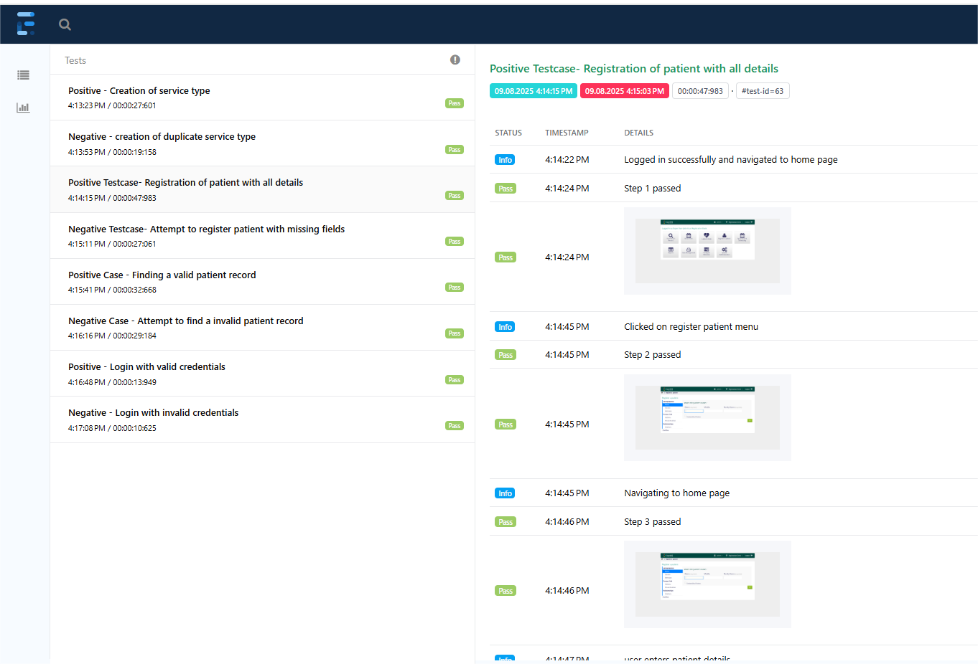
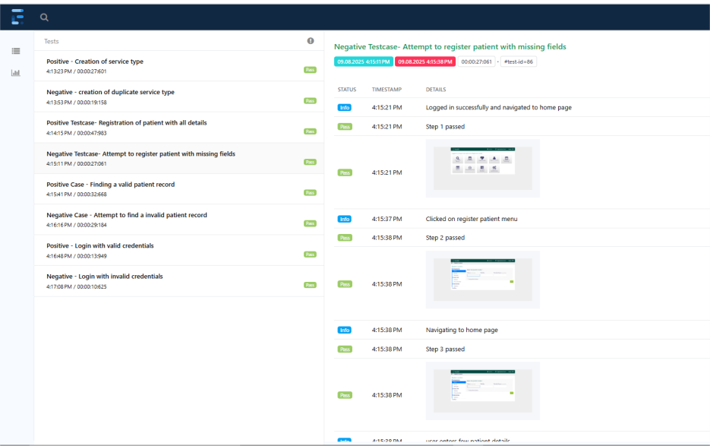
Extent reports-i

Slide 20
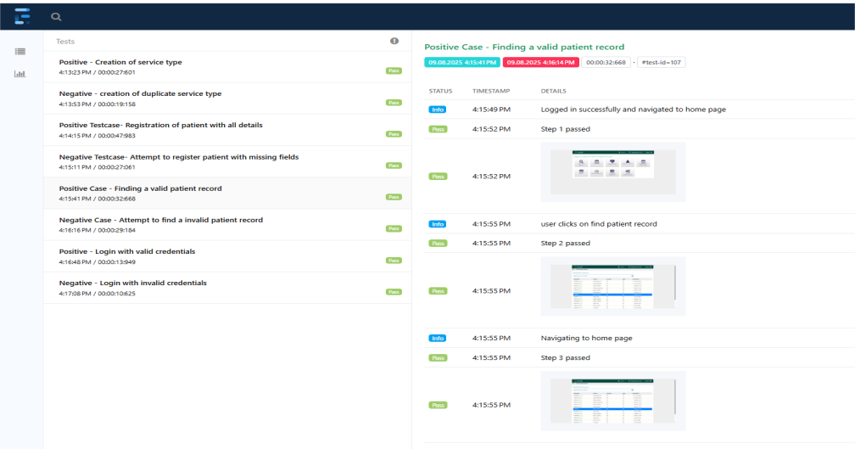
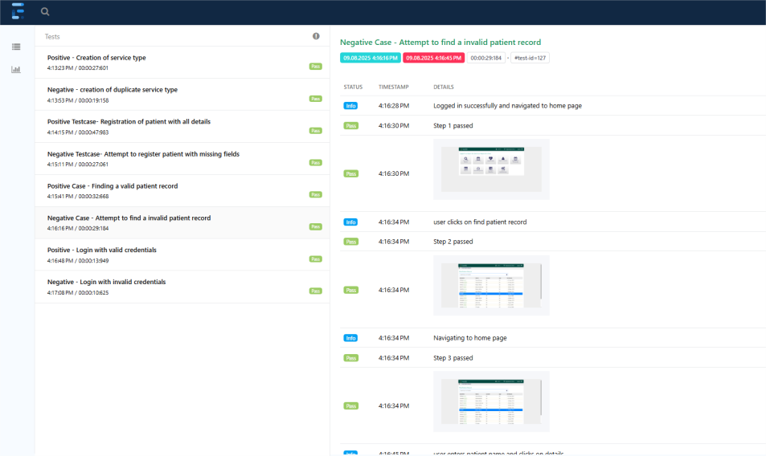
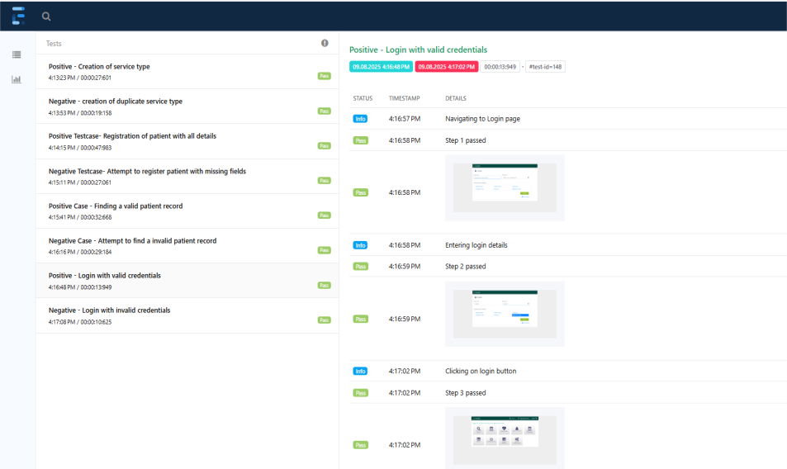
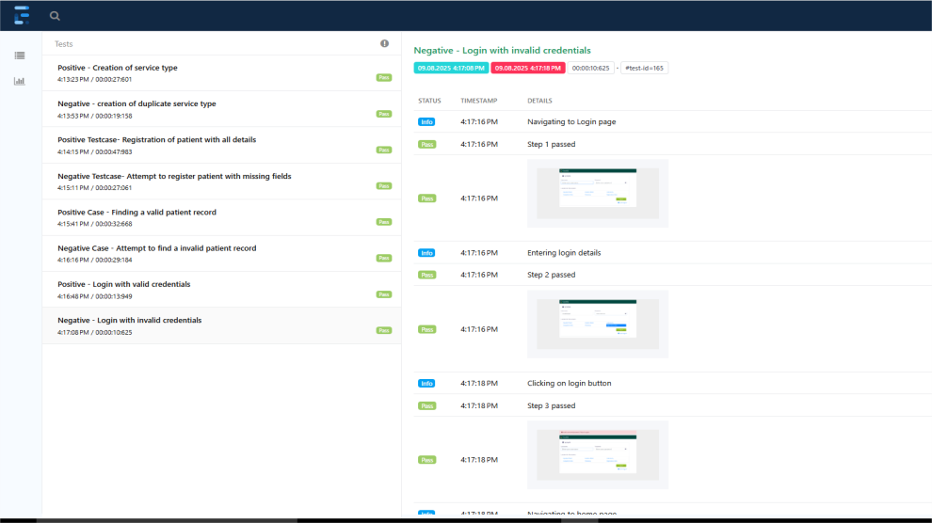
extent reports-ii

Slide 21
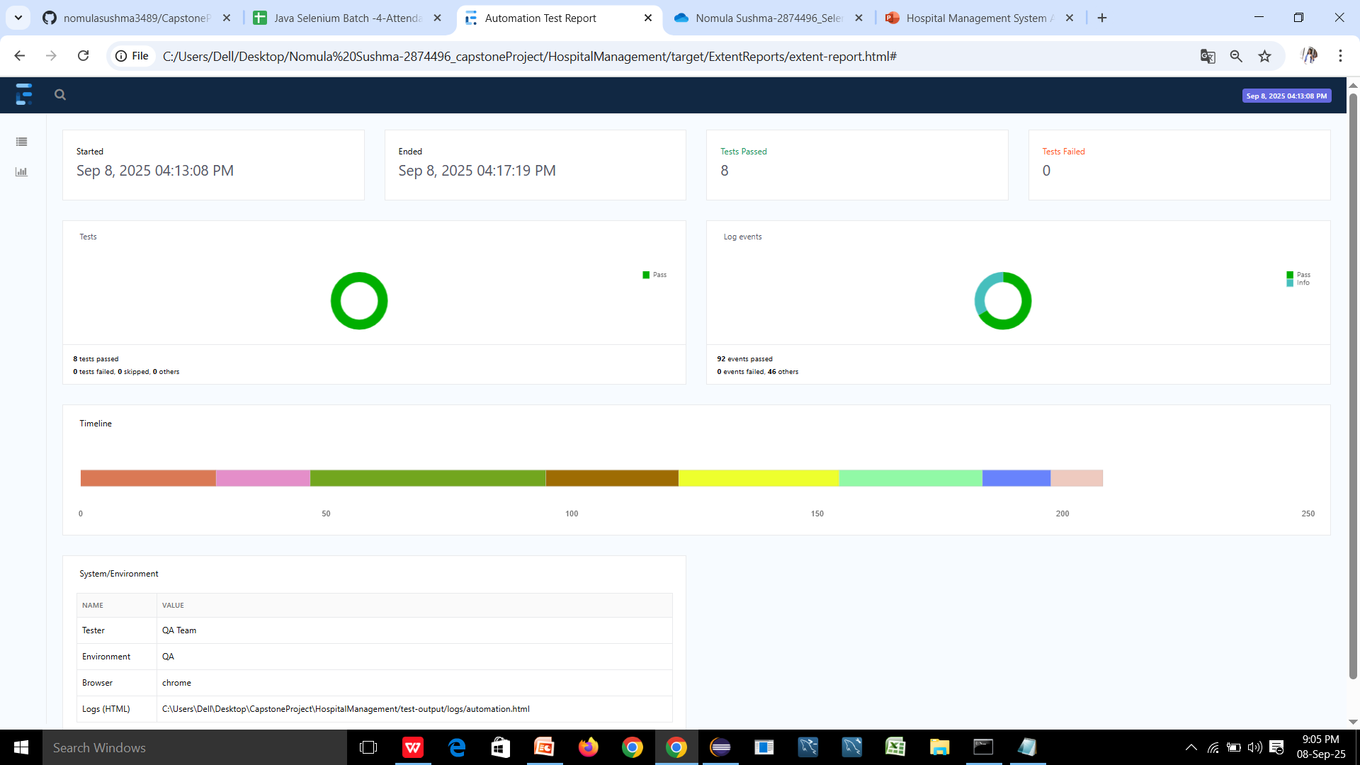
Extent report-iii

Slide 22
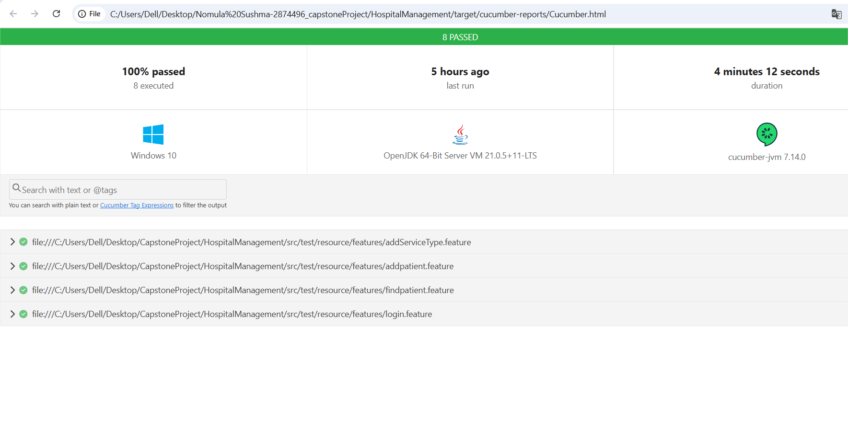
cucumber.html

Slide 23
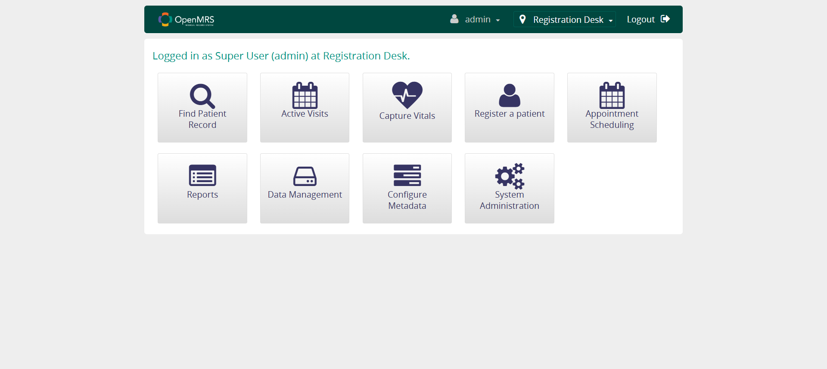
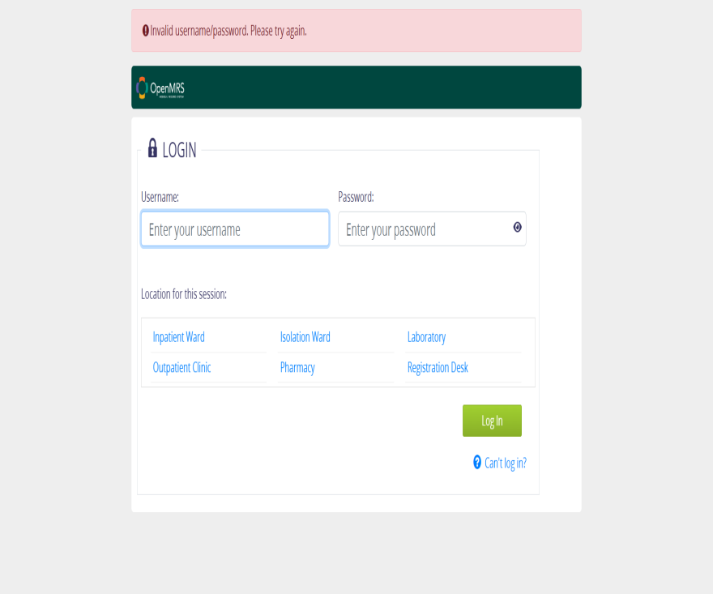
Screenshot-I testcase-1: login functionality
Positive
Negative

Slide 24
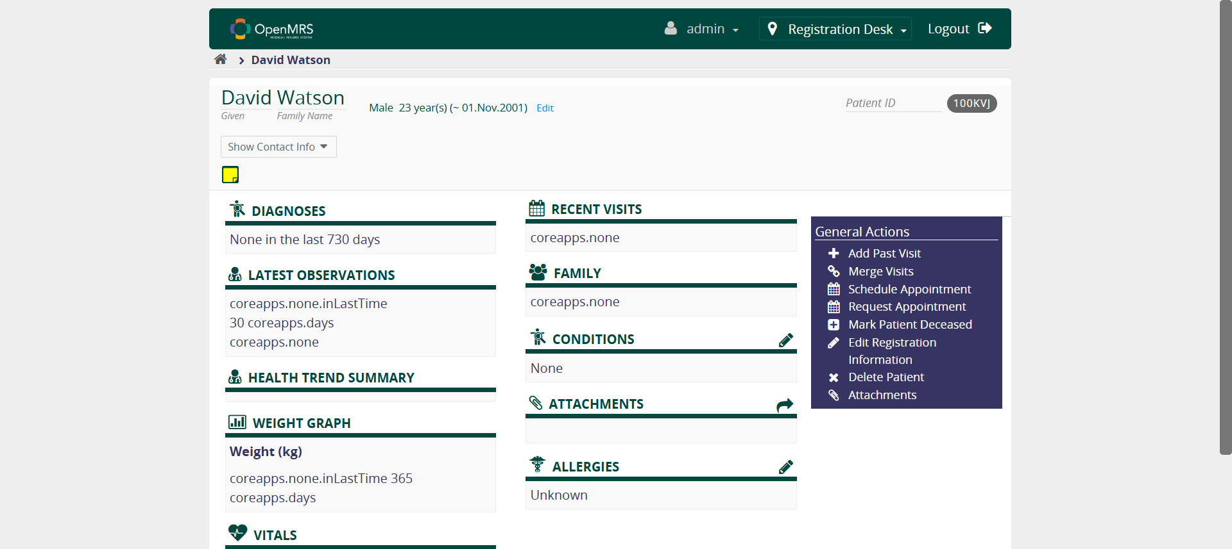
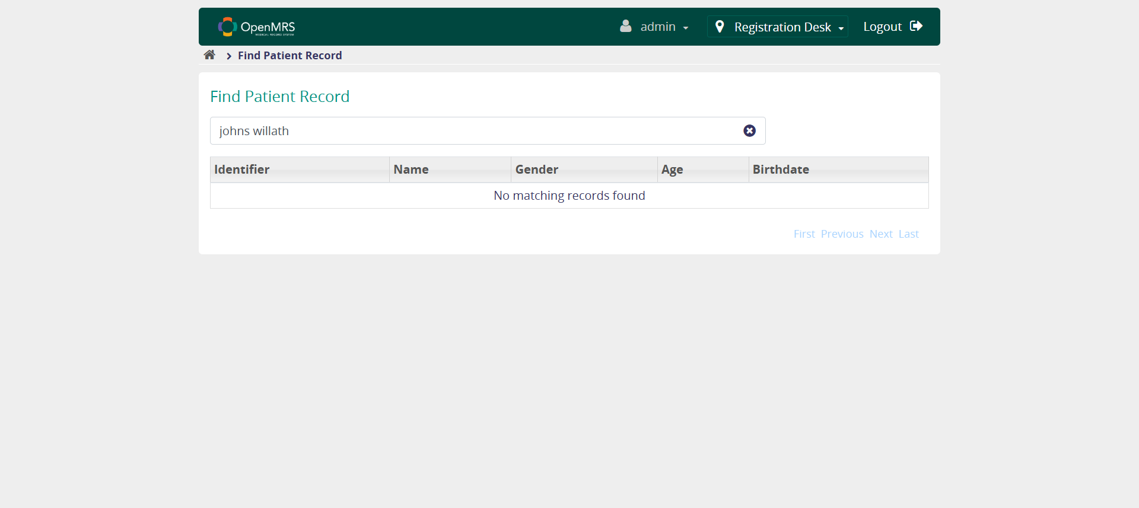
screenshot-ii testcase-2: finding patient record
Positive
Negative

Slide 25
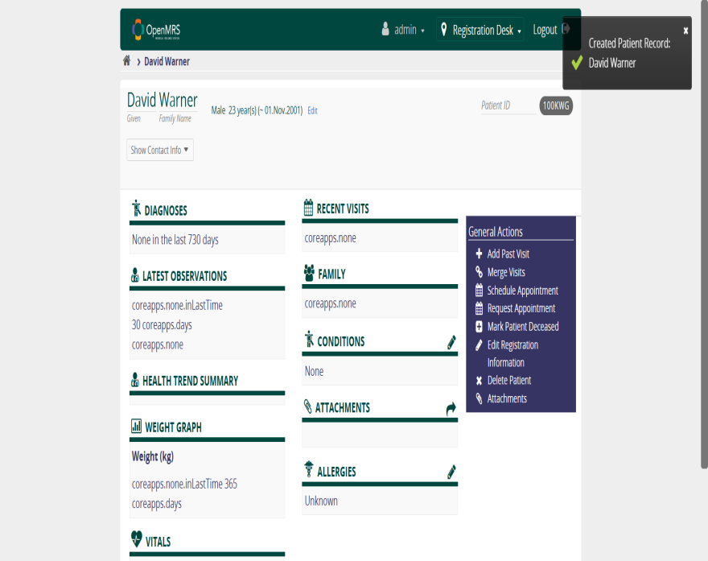
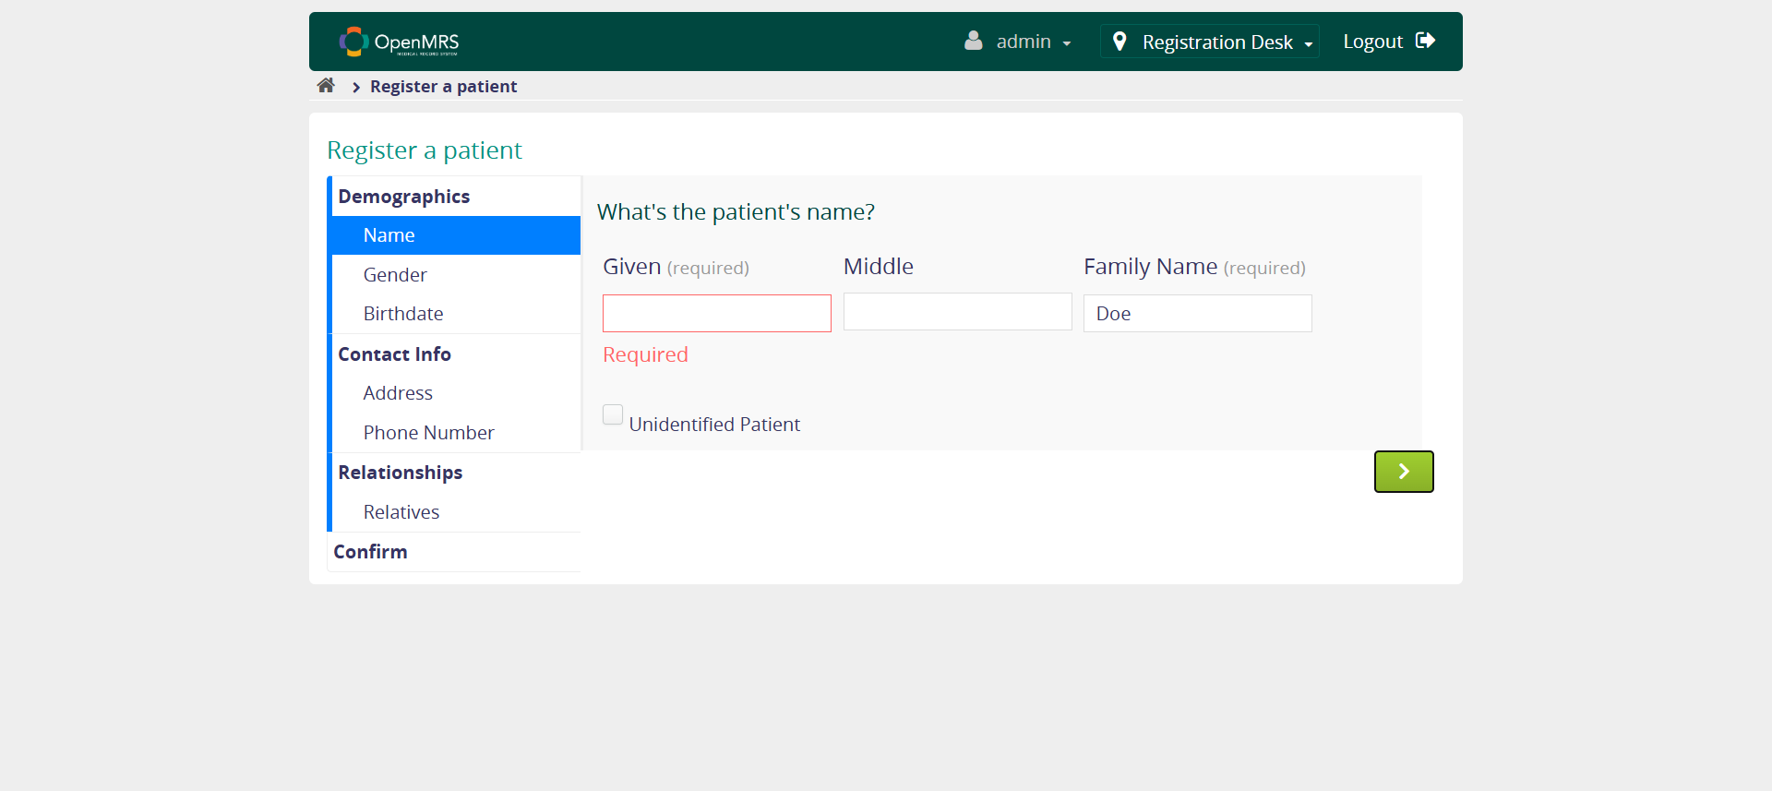
Screenshot-iii testcase-3 register patient
Positive
Negative

Slide 26
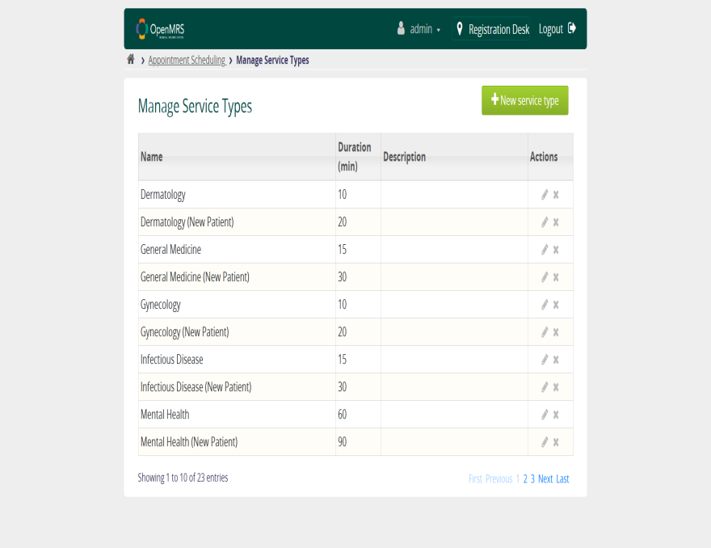
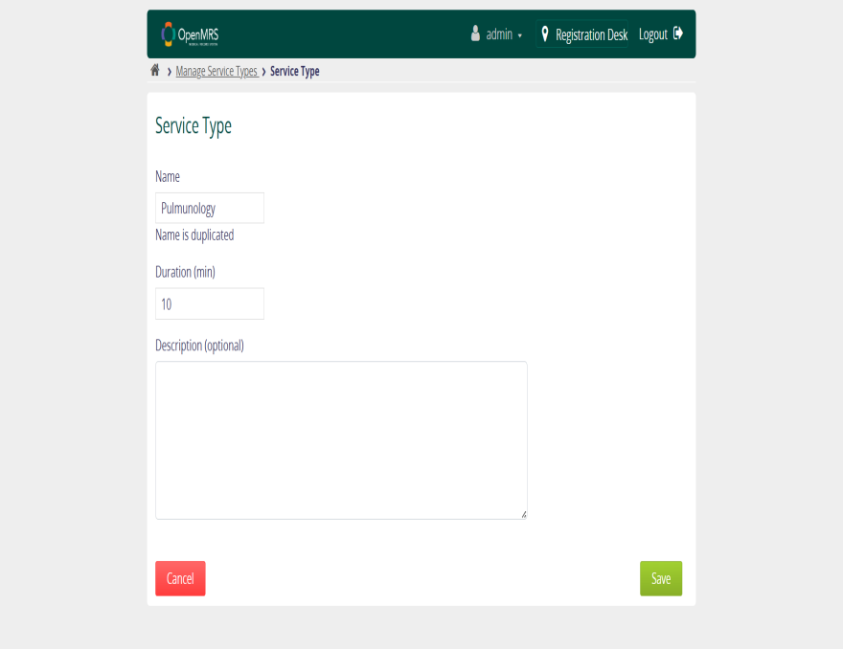
Screenshot-iv testcase-4 adding service type
Positive
Negative

Slide 27
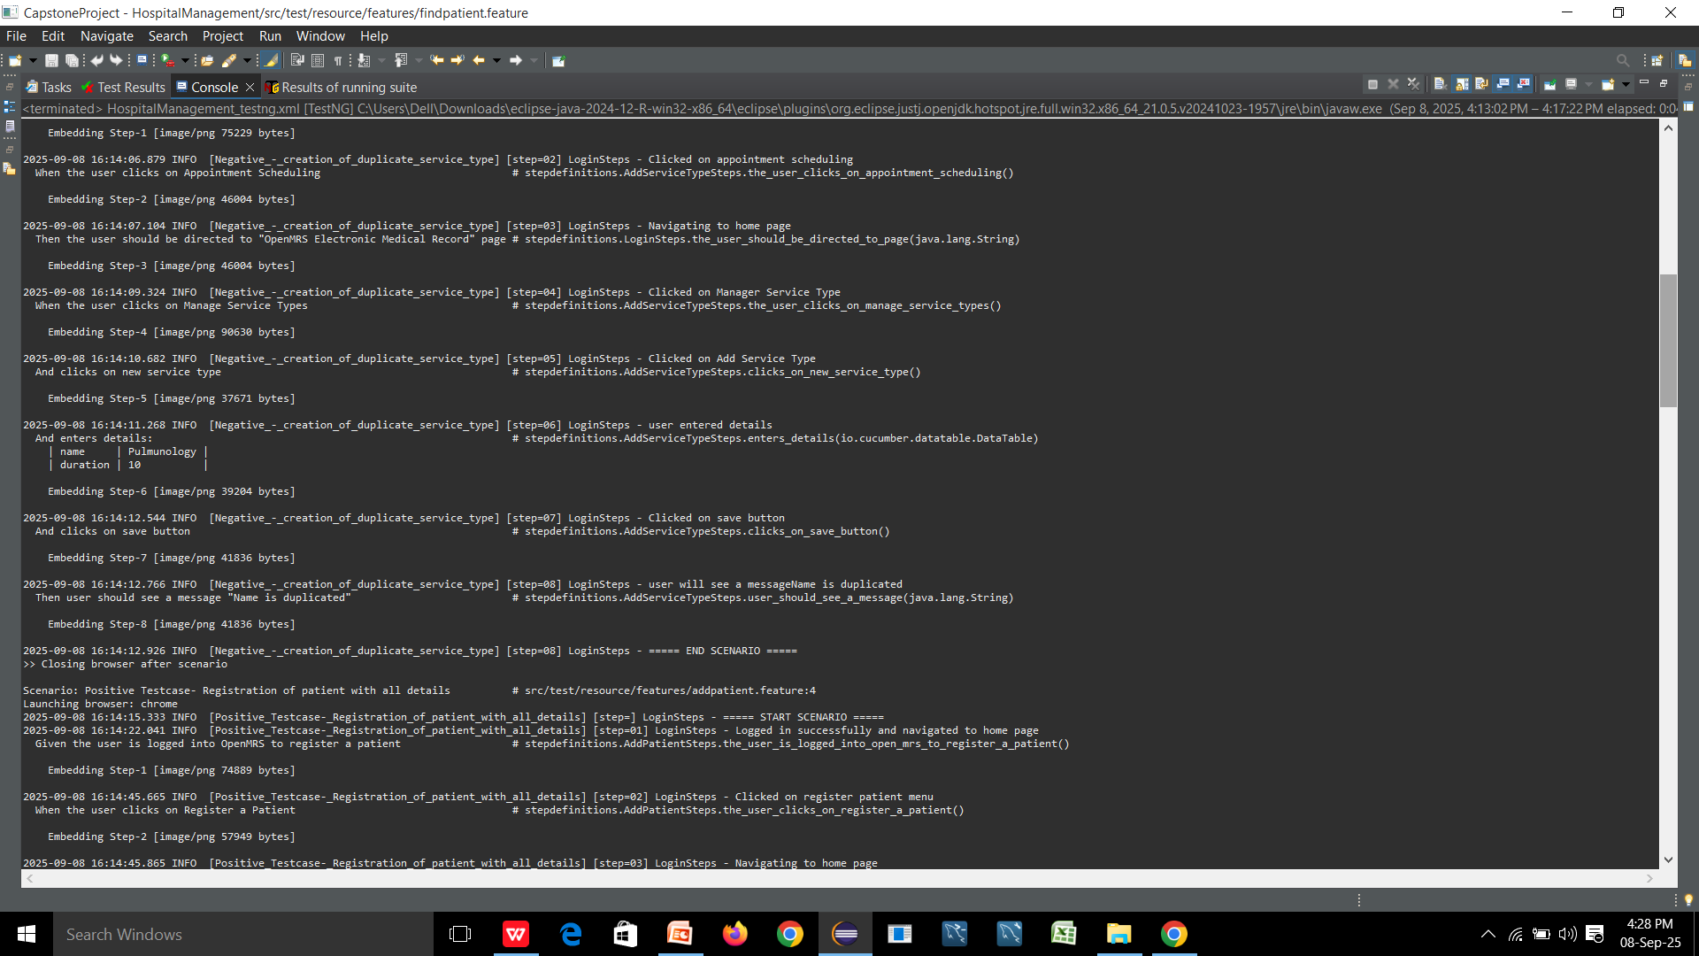
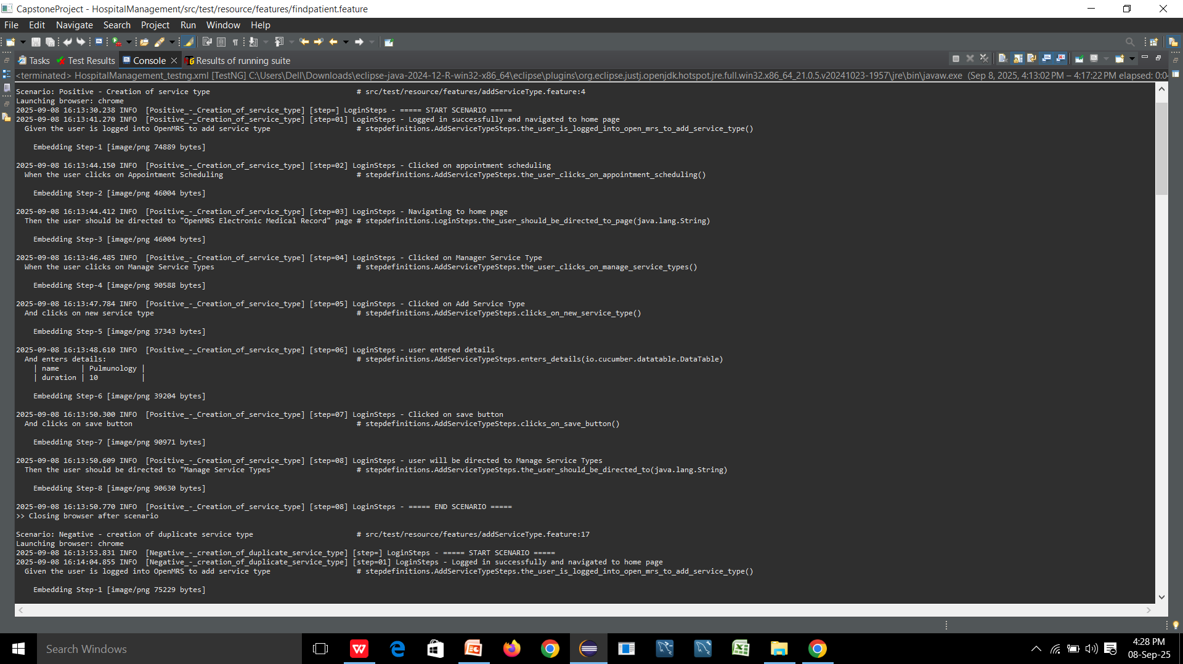
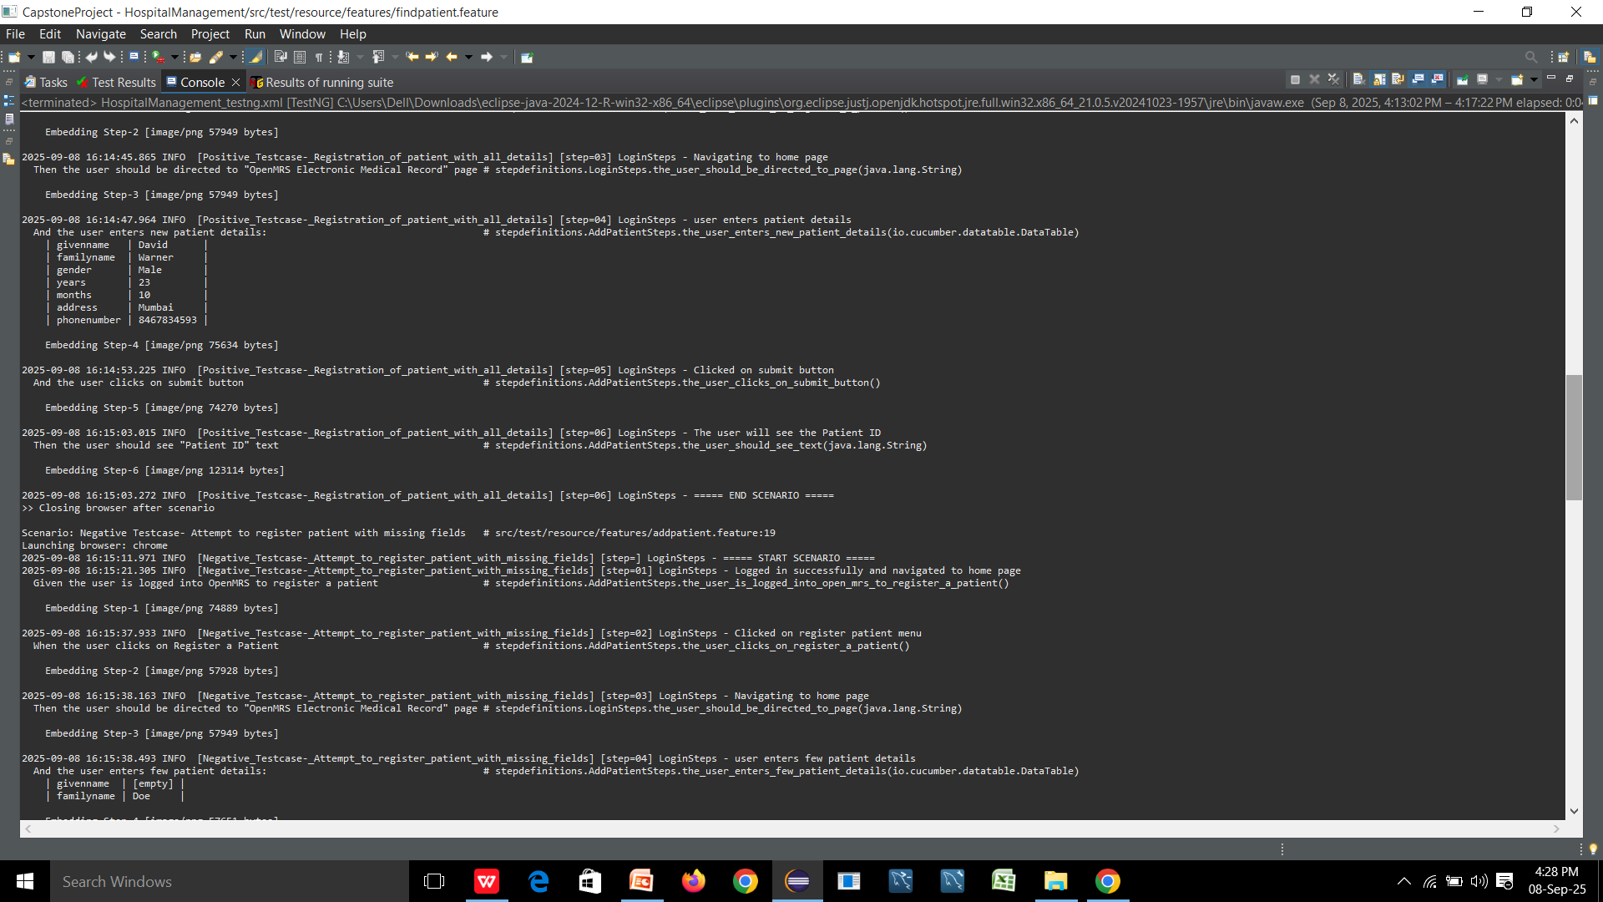
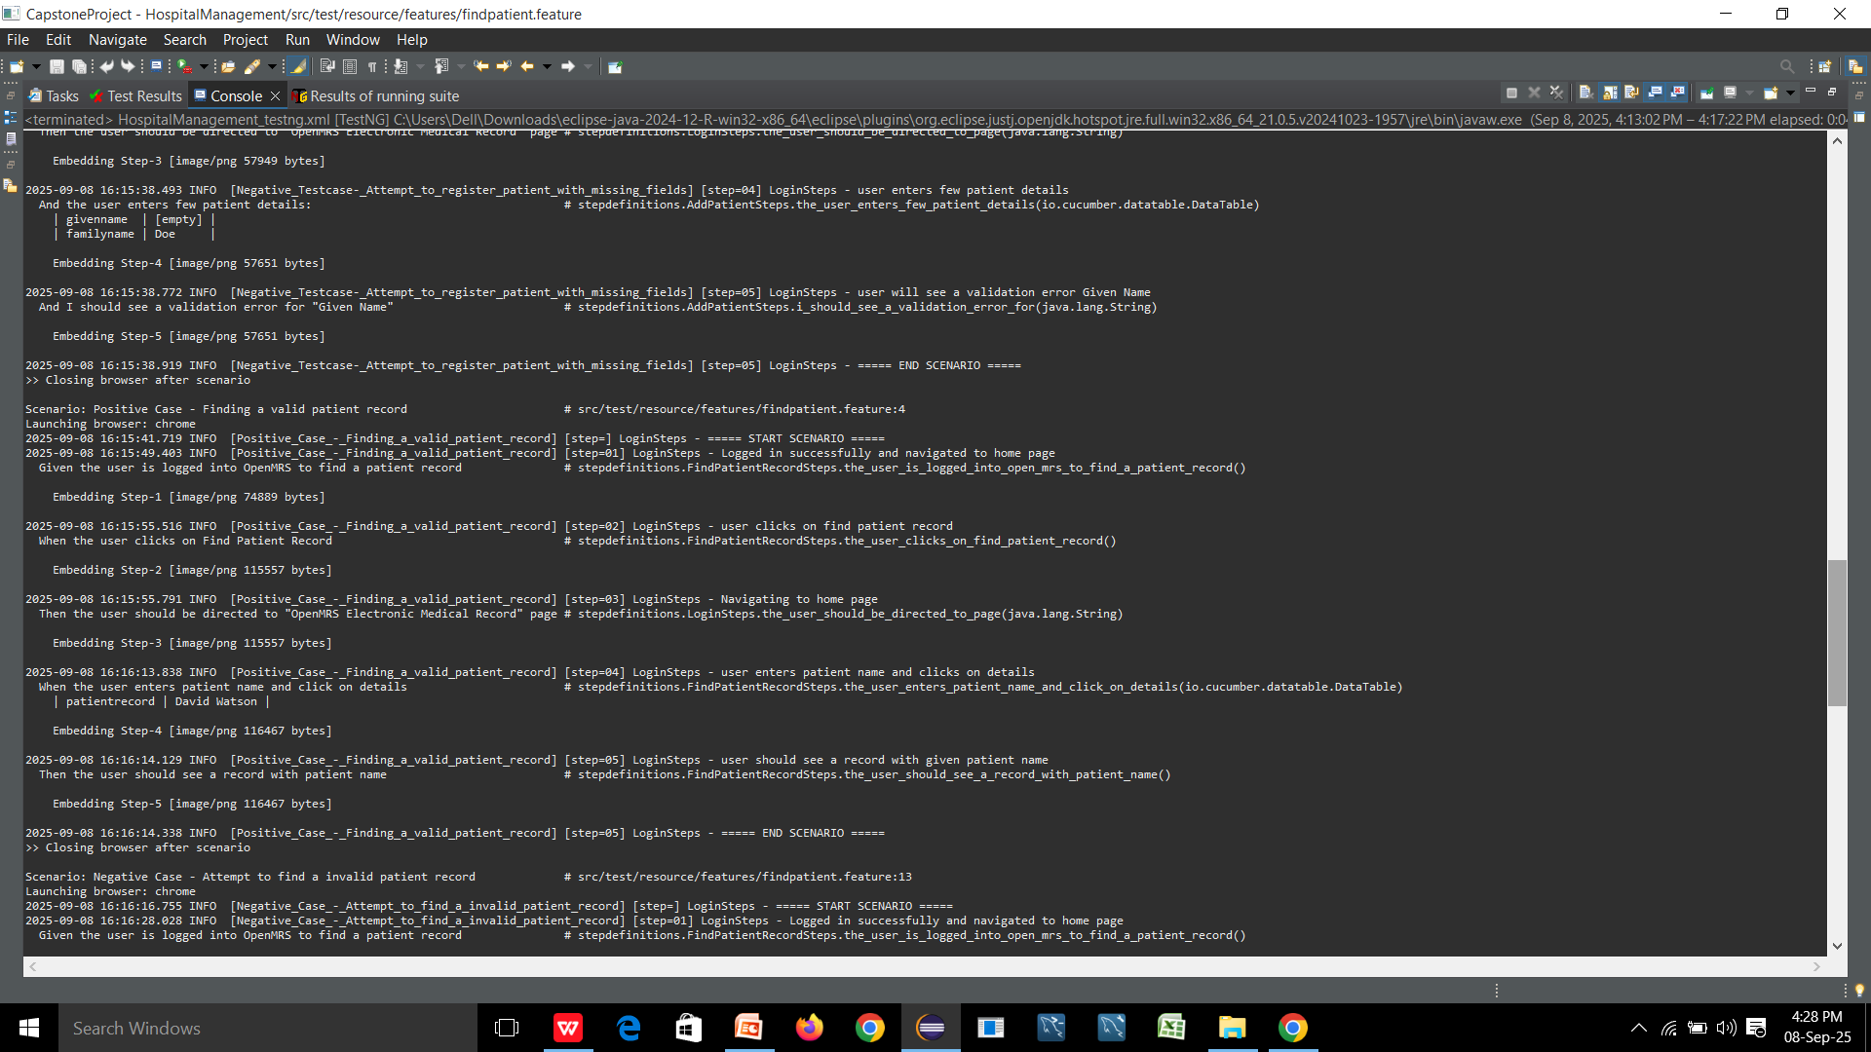
console output-i

Slide 28
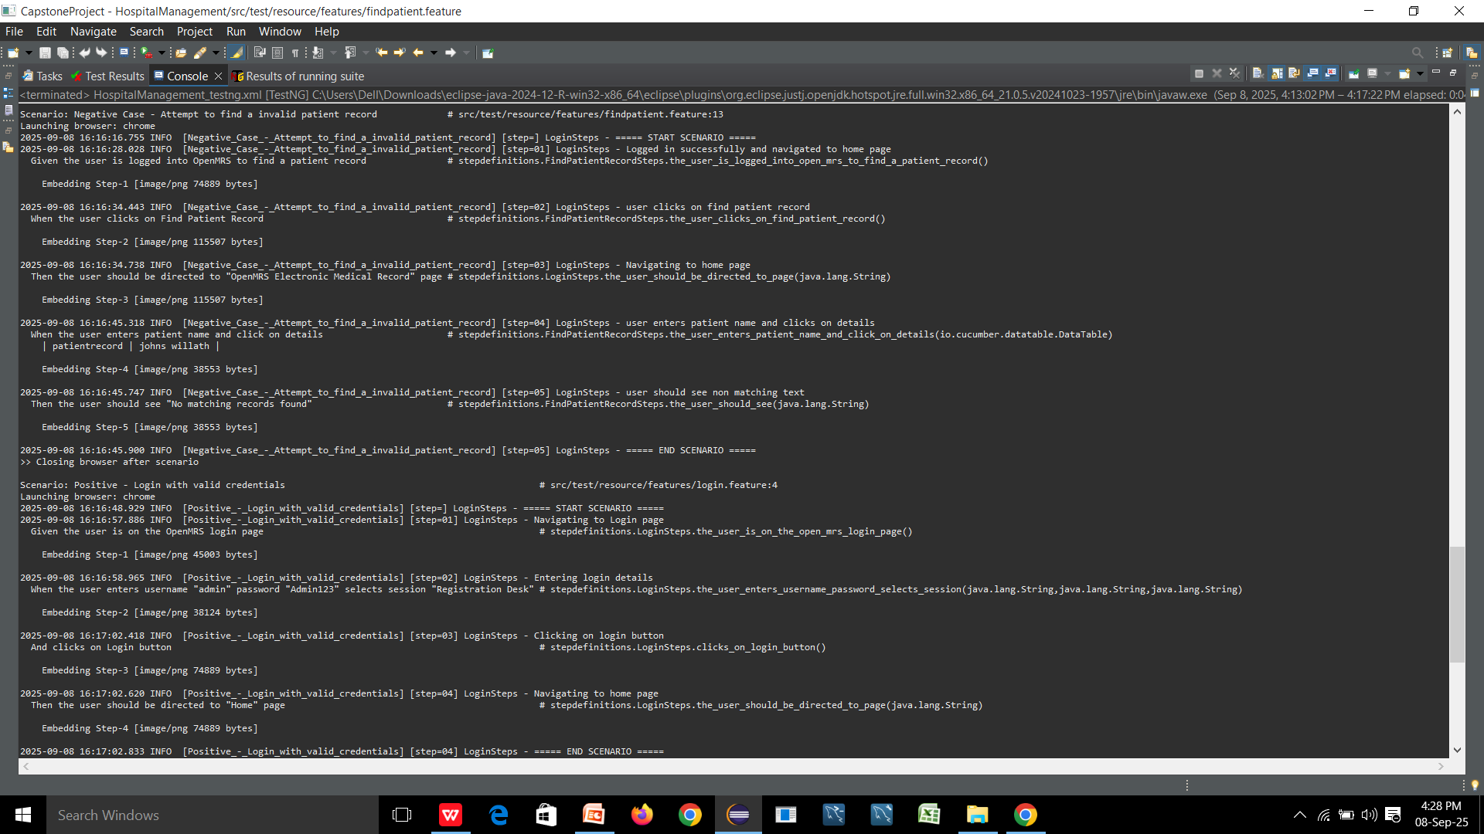
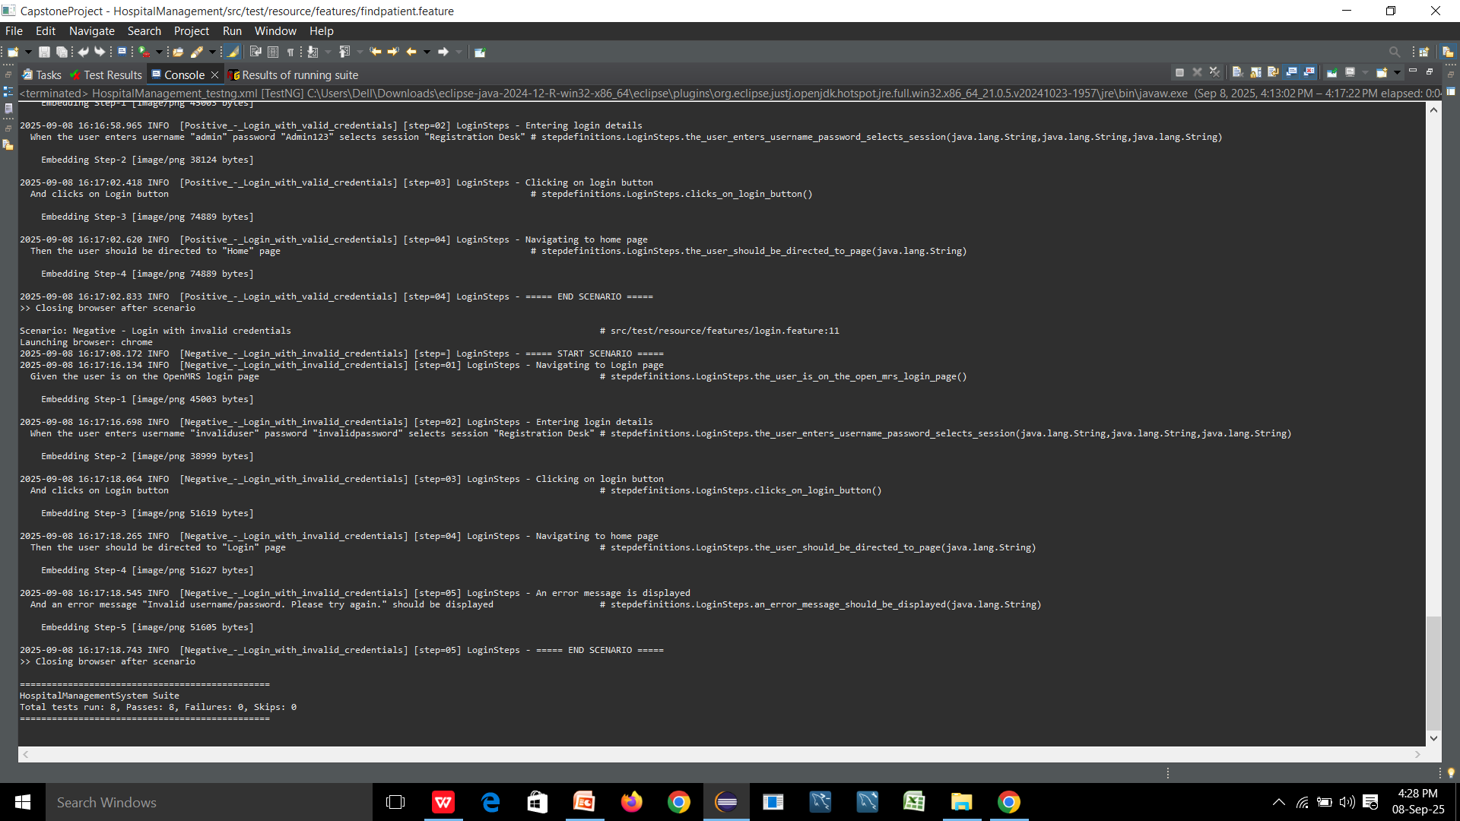
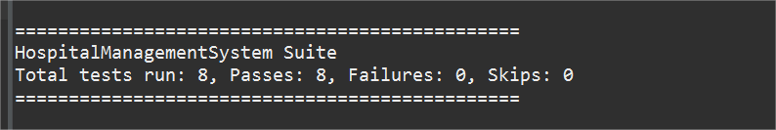
console output-ii

Slide 29
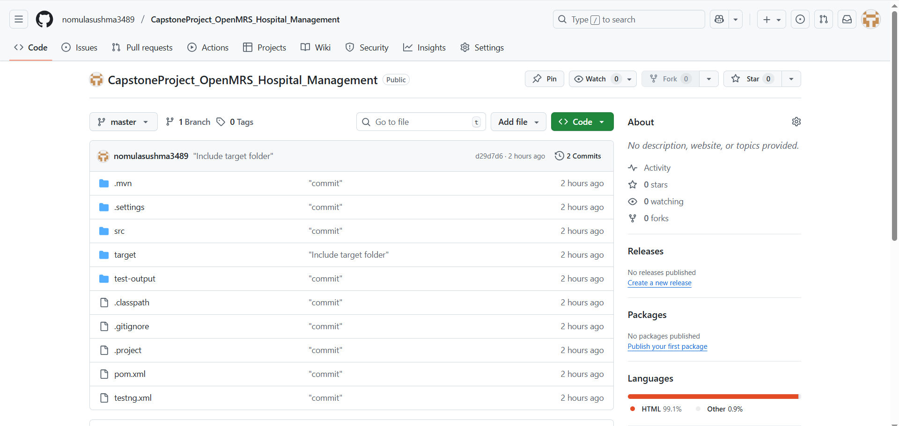
git repository
https://github.com/nomulasushma3489/CapstoneProject_OpenMRS_Hospital_Management.git

Slide 30
THANK YOU

